Slide 1
Conjoint Analysis

Slide 2
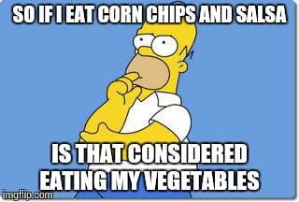

Slide 3
Why Conjoint Analysis?
Asking direct questions about preferences often leads to unenlightening answers.
What load would you like to pay on your mutual fund?
What annual fee would you like?
Would you like online access to your funds?
Consumers want everything and they want it for free!

Slide 4
What should Portland Trailblazers do?
Obj:
Constraints:
Options:

Slide 5
What is the most important Attribute for Customers?
Seat Location =
Number of Games =
Ticket Price =
Promotional Item =

Slide 6
Can Portland Raise Ticket Prices?
Utility of Current Ticket Prices and Locations:
300 bb + $15 =
300 c + $25 =
300 M + $35 =
200 M + $60 =
Consider → 300M + $60 =

Slide 7
Utility Buffer= .27 = (.28-.01)
How much price can be increased to decrease utility by .27?
Difference in utility between $60 and $35 = 1.12 = .126-(-1.00)
How much is the value of a single utility point?
(60-35)/1.12= 22.15
Price increase = .27*22.15 = 6.08

Slide 8
Utility Buffer =
.28 (current utility of 300M) -.01 (current utility of 200 M) = .27
For $25 (between $60 and $35), range in utility -> 1.12
% of utility drop allowed = .27/1.12 = 24%
$ range for 1.12 drop = $25
Allowed price increase = 24%*$25 = $6
$35
$60
.12
-1
1.12

Slide 9
Can Portland Raise Ticket Prices?
Utility of Current Ticket Prices and Locations:
300bb + $15 = -.07523=-.73+.65
300C + $25 = -.21705
300M + $35 = .28336
200M + $60 =.00891
300M + $60 = -.843

Slide 10
What about the promotions?
What is the Willingness to pay for hot dogs?
Compare it with the no promotions offer
https://docs.google.com/presentation/d/1uc3GfMYKuzgjYfPILK6ql05FpU8F5Z1rTjsIb-7CGUs/edit?usp=sharing

Slide 11
Difference between ticket Price utilities = .657+1=1.657
Price for a utility point = 27.17
Difference between Hot Dog and no promotion = .17-(-.32)=.49
Price for a hot dog = .49*27.17 = 13.31
Profit from hot dog= 13.31-3.25 = 10.10

Slide 12
Value of hot dog
Utility of hot dog relative to no promotion =.17+.32 = .49 (utility buffer)
Range of prices = $45
Range of price utilities = 1.65
% of utility available to give = .49/1.65 = 29.67%
Increase price by 29.67% of $45 = $13.33
$15
$60
.65
-1
1.65

Slide 13


Slide 14
Where can we apply conjoint?

Slide 15
What are the risks and assumptions?

Slide 16
What are the risks/assumptions?
Assumption is that customers have decided to visit the stadium
It is not about customers making a choice between visiting the stadium vs watching a movie
It is about prior customers not new customer acquisitions
This is about purchase intention, and that may not necessarily correlate with behavior

Slide 17
Takeaways

Slide 18
takeaways
Find the value in the different options or features of a product
How much people are willing to pay for each option or bundle of options
Design combination of offers that would maximize consumer value and firm profits

Slide 19
How does conjoint map to multinomial logit?

Slide 20
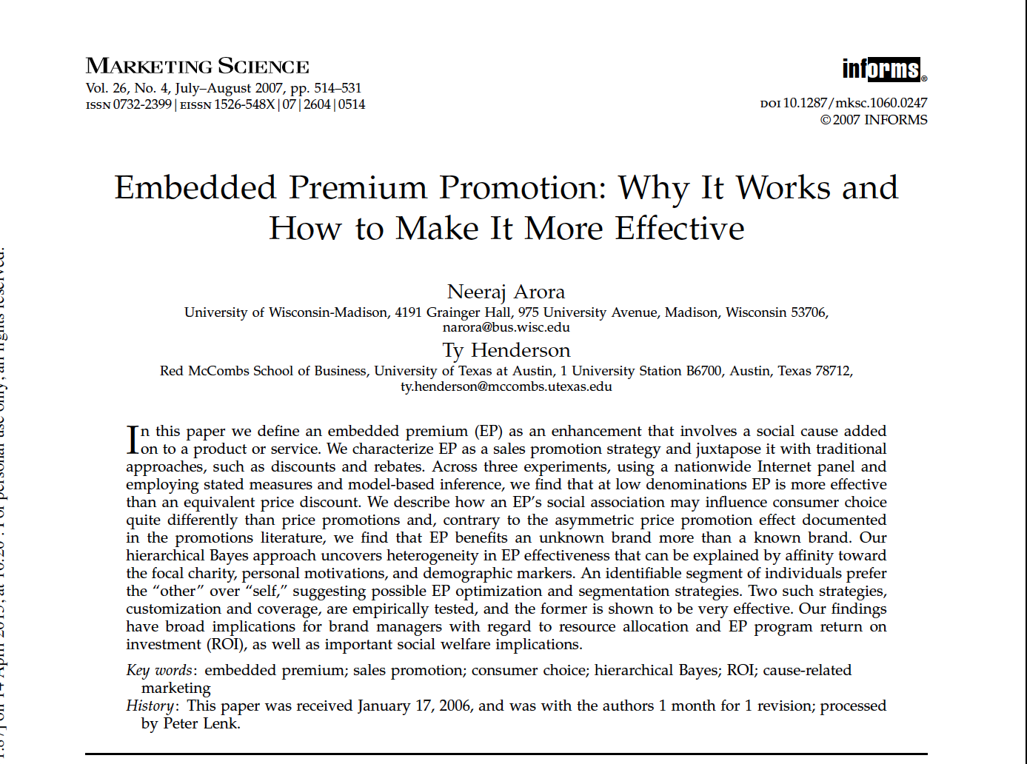

Slide 21
Choice-Based Conjoint Example
Attribute | Levels
Brand | National Bank, Capital One
Interest rate | 9.9% APR, 12.9% APR
Payback percentage | 1%, 5%
Payback destination | WHO, WHO & Habitat, charity of choice, cash back

Slide 22
Choice-Based Conjoint Arora and Henderson 2007
Respondents indicate their charity preference by selecting one cause from five:
American Cancer Society, World Health Organization, Habitat for Humanity, SchoolWise, National Wildlife Federation
Choice-based conjoint, 16 tasks
Respondent characteristics
Usage, cause affinity, demographics

Slide 23
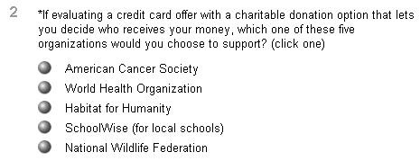
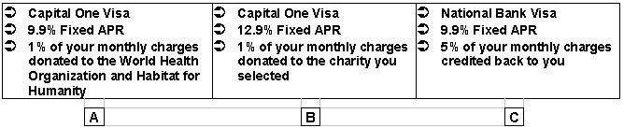
Example Choice Task

Slide 24
Data Collection
National Internet Survey (n = 495)
60% female
62% married
57% over age 44
41% w/ at least bachelor’s degree
24% w/ household income > $75K

Slide 25
Choice Design Matrix Coding
Nine dummy variables
Brand [x1] (Capital One = 1)
Interest rate [x2] (9.9% = 1)
Level (payback %)* Payee interaction (cash back, charity etc) [x3..x9]

Slide 26
Model Design
U_{ij} = β_{1,ij}x₁ + β_{2,ij}x₂ + β_{3,ij}x₃ +
b_{4,ij}x₄ + b_{5,ij}x₅ + b_{6,ij}x₆ +
b_{7,ij}x₇ + b_{8,ij}x₈ + b_{9,ij}x₉
Capital One
9.9% APR
1% Cash
5% Cash
5% WHO
1% Both
5% Both
1% Choose
5% Choose

Slide 27
Model Design
Product Option 1 – Capital One, 9.9% APR, 1% cash donated to WHO and Habitat
U (product option 1) = β_{1,ij}1+β_{2,ij}1+ β_{6,ij}1

Slide 28
Embedded Premium Conclusion
People are willing to trade off cash back % with the choice of giving the cash back to a charity.
People prefer to give cash back to a charity and are willing to take a lower % of cash back offer if the destination is a charity

Slide 29
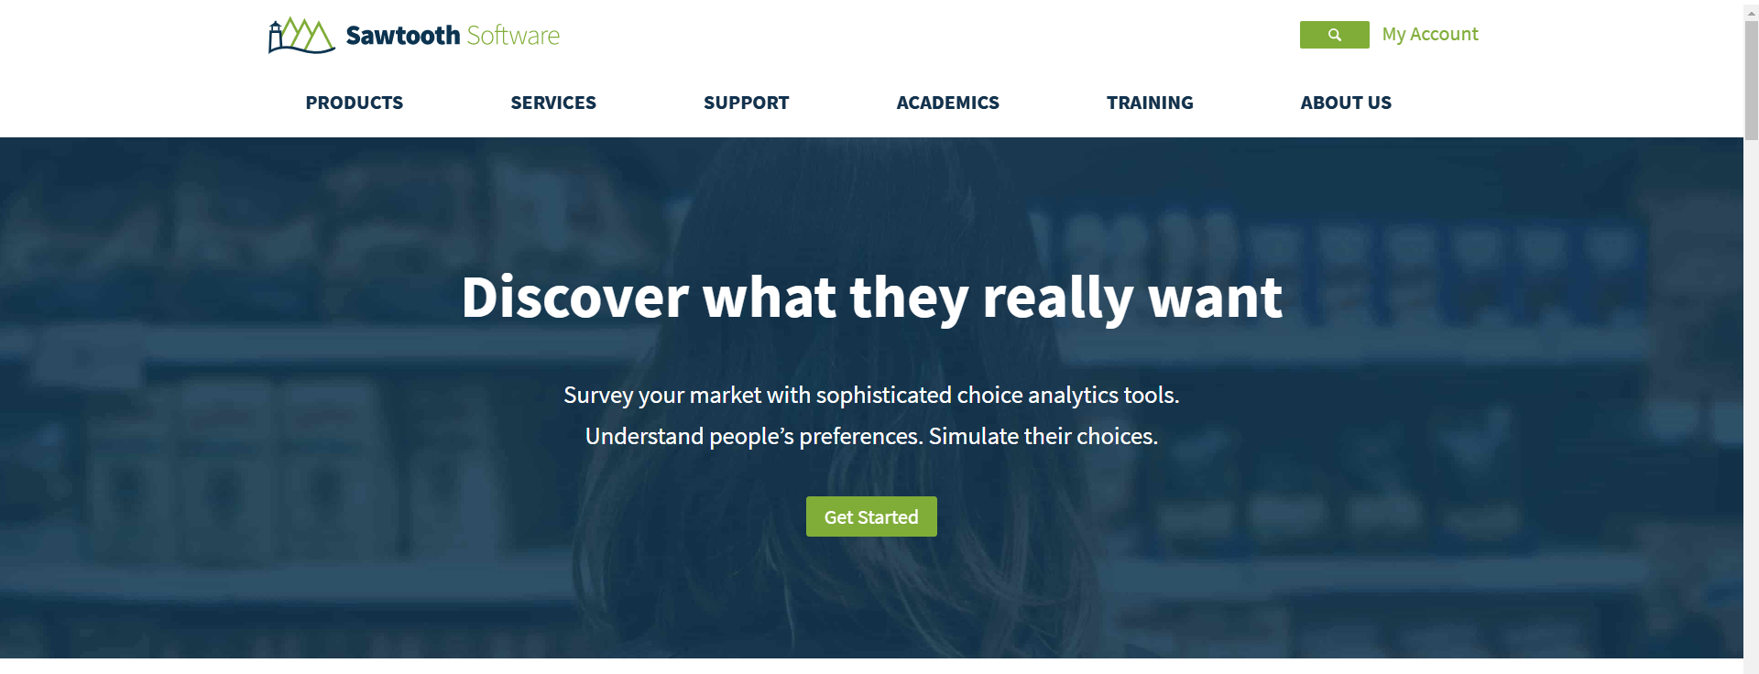

Slide 30
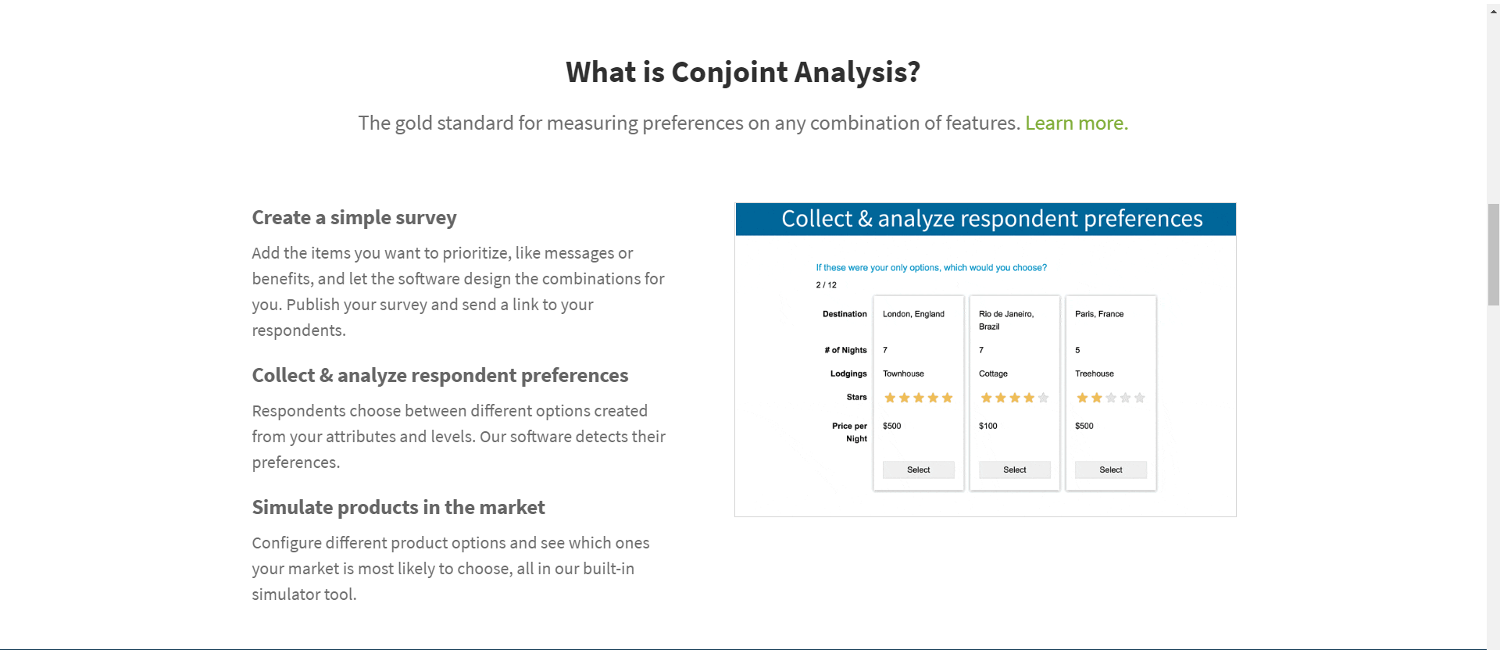

Slide 31

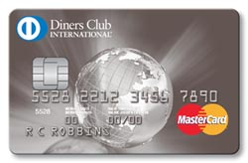


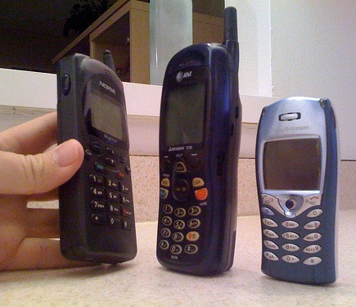

How Has the Method Been Applied?
Room Configuration
New Card Benefits
Baltimore Ravens Logo
New Services
New Hotel Concept for Business Travelers
First AT&T cell phones
Notes:
Some Applications
AT&T’s first cellular telephone (conjoint is great for new products!)
Baltimore Raven’s logo.
Courtyard by Marriott (see article below for details)
FedEx new service.
IBM RISC 6000 workstation
Diner’s Club Card
Squibb’s Captopril antihypertensive.
UPS Service Study
U.S. Navy Reenlistment Benefit Packages
For Courtyard By Marriott…It’s All About Value
Posted on June 26th, 2007 (0 Comments)
Last week while in Cleveland on business, I was booked to stay in a Courtyard by Marriott hotel. This chain was designed by a few Wharton School of Business professors using conjoint analysis, a market research technique focused on understanding what product attributes consumers value. Ever since I read an academic article written by Jerry Wind, Paul E. Green, Douglas Shifflet, and Marsha Scarbrough which describes how the hotel chain was designed (“Courtyard by Marriott: Designing a Hotel Facility with Consumer-based Marketing Models,” Interfaces, January – February 1989), I’ve wanted to stay at a Courtyard by Marriott.
…. You may be wondering how conjoint analysis works. Imagine being asked what package you prefer: Package A (3 story hotel, courtyard design, $65) vs. Package B (12 story hotel, L shaped design, $55). Once you’ve answered this question, you’ll be asked for your preference between 2 new packages: for example Package C (3 story hotel, L shaped design, $55) vs. Package D (3 story hotel, L shaped design, $60). You can imagine that after being asked about your preferences in this manner, say 10 times (with the package characteristics being slightly different each time), your preferences and valuations for specific attributes can be teased out...
The results of Courtyard by Marriott’s conjoint analysis are fascinating. Conjoint found that business travelers (primary core target audience) didn’t sufficiently value traditional hotel attributes like an “action” lounge (…their phrasing, not mine), room service, upscale restaurant, bellman, concierge, or airport transportation. Instead, targeted business travelers valued items like a room that is slightly larger than most (1 foot), sink in a separate area, coffee maker, and décor similar to new Hiltons.
This analysis gave Marriott’s management confidence they were creating a hotel that best served their clientele. The real proof of the benefits of focusing on customer value is the overwhelming success of the Courtyard by Marriott chain. Starting off with 3 test hotels in 1983, the chain now has 699 worldwide locations.
So when Courtyard by Marriott claims that it is “designed by business travelers for business travelers” (this slogan was recently modified to be “redesigned by business travelers for business travelers”) …they aren’t kidding.
Source of article: http://www.pricingforprofit.com/pricing-strategy-blog/for-courtyard-by-marriott-s-all-about-value.htm

Slide 32
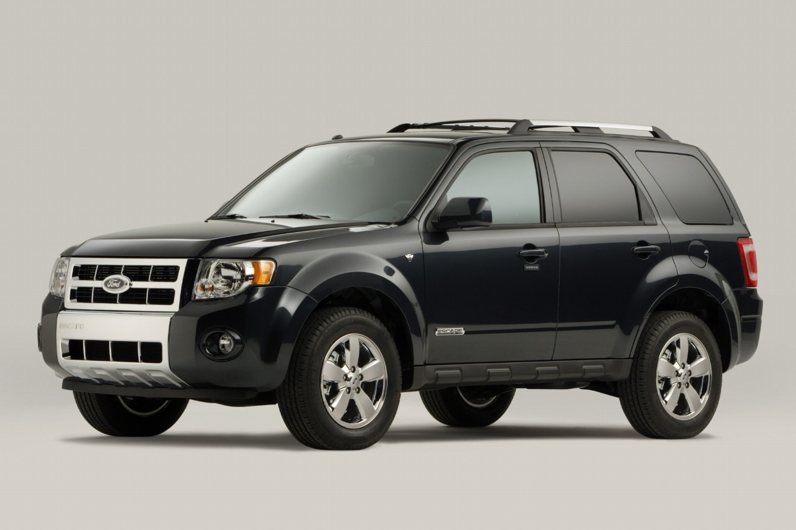
Alternatively, Directly Asking Can Be Misleading . . .
When people are directly asked, . . .
“Durability
+ Quality
+ Reliability”
. . . but from the conjoint consumers really care about
Price + Design
Notes:
I (KS) just had an alum from Ford stop by and we talked about this real example.
Here we can highlight the “mean-say” gap. Consumers say one thing, but mean another. They may be completely unaware of what they value or are not willing to admit it. In this example, American (this does not happen in Europe or Asia), consumers do not want to admit that they are cheap (caring about price) and superficial (care only about external appearance other than the price).

Slide 33

It Works with Services Too…
All that is needed is a decomposition of the attributes
Mutual Fund = Past Returns + Fees + Brand Name + Online Access
Notes:
SERVICES!
Ask students: What are the attributes that consumers care about in a mutual fund?

Slide 34
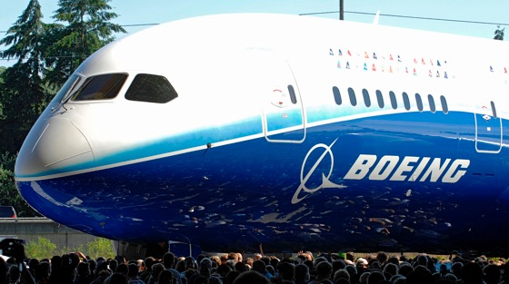
What about B2B?
If you were Boeing, what are your customers willing to pay for your new aircraft?
Value of Aircraft =
+ Capacity
+ Max Range
+ Fuel Efficiency
+ Price
+ Service Contract + . . .
Notes:
Then, how would they do so in a B2B environment like Boeing…

Slide 35
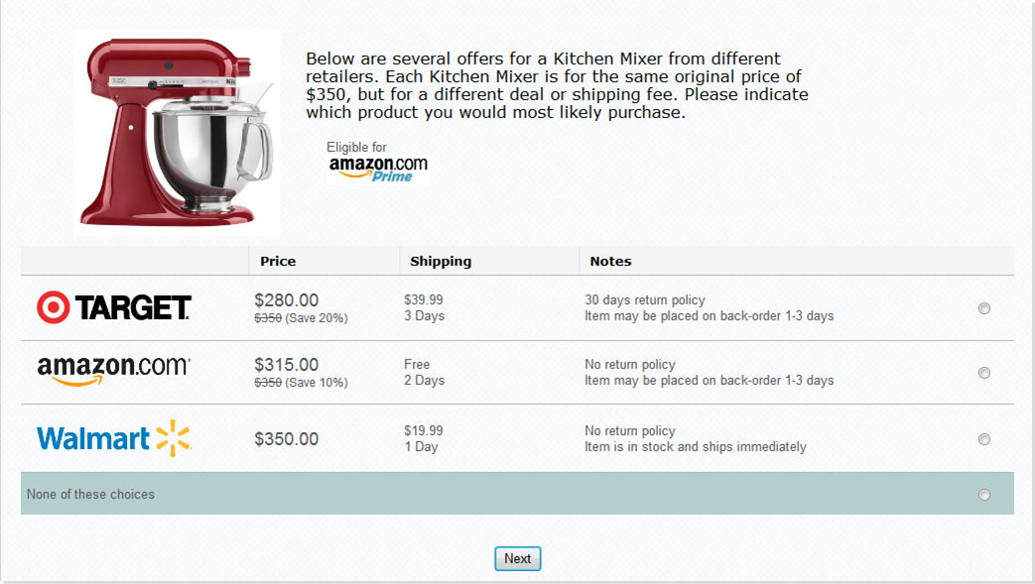
Choice-Based Conjoint Analysis

